Slide 1





ATHLETE PERFORMANCE ANALYTICS DASHBOARD
SAJIN P
MORISHA MACI V S
MOHAMMED ASHFAQ A
SESHA SAI N

Slide 2

PROBLEM STATEMENT
THE PROBLEM IS LACK OF A CENTRALIZED SYSTEM TO EFFICIENTLY MANAGE, ANALYZE, AND MONITOR ATHLETE PERFORMANCE AND TRAINING WHICH SUPPORT ATHLETE HEALTH AND TRAINING

Slide 3

EXISTING SYSTEM
the existing system are generally maintained using paper-based records, Excel spreadsheets.
LIMITATIONS
  MANUAL DATA ENTRY
  DATA DUPLICATION
  MANUAL CALCULATION
  LIMITED HISTORICAL ANALYSIS
  LIMITED SECURITY
  LACK OF CENTRALIZED STORAGE

Slide 4
SOLUTION
A CENTRALIZED JAVA-DBMS BASED ANALYTICS SYSTEM THAT MANAGES ATHLETE DATA, MONITORS TRAINING AND PERFORMANCE, AND PROVIDES WORKLOAD AND STORE DATA WHICH INSIGHTS TO SUPPORT HEALTHIER AND MORE EFFECTIVE TRAINING.

Slide 5

TECH STACKS
  Application Logic : Java
  Database Connectivity: JDBC
  Data Storage: MySQL Database
  Query Execution: MySQL Workbench
  API and Javascript server handling: Node.js

Slide 6

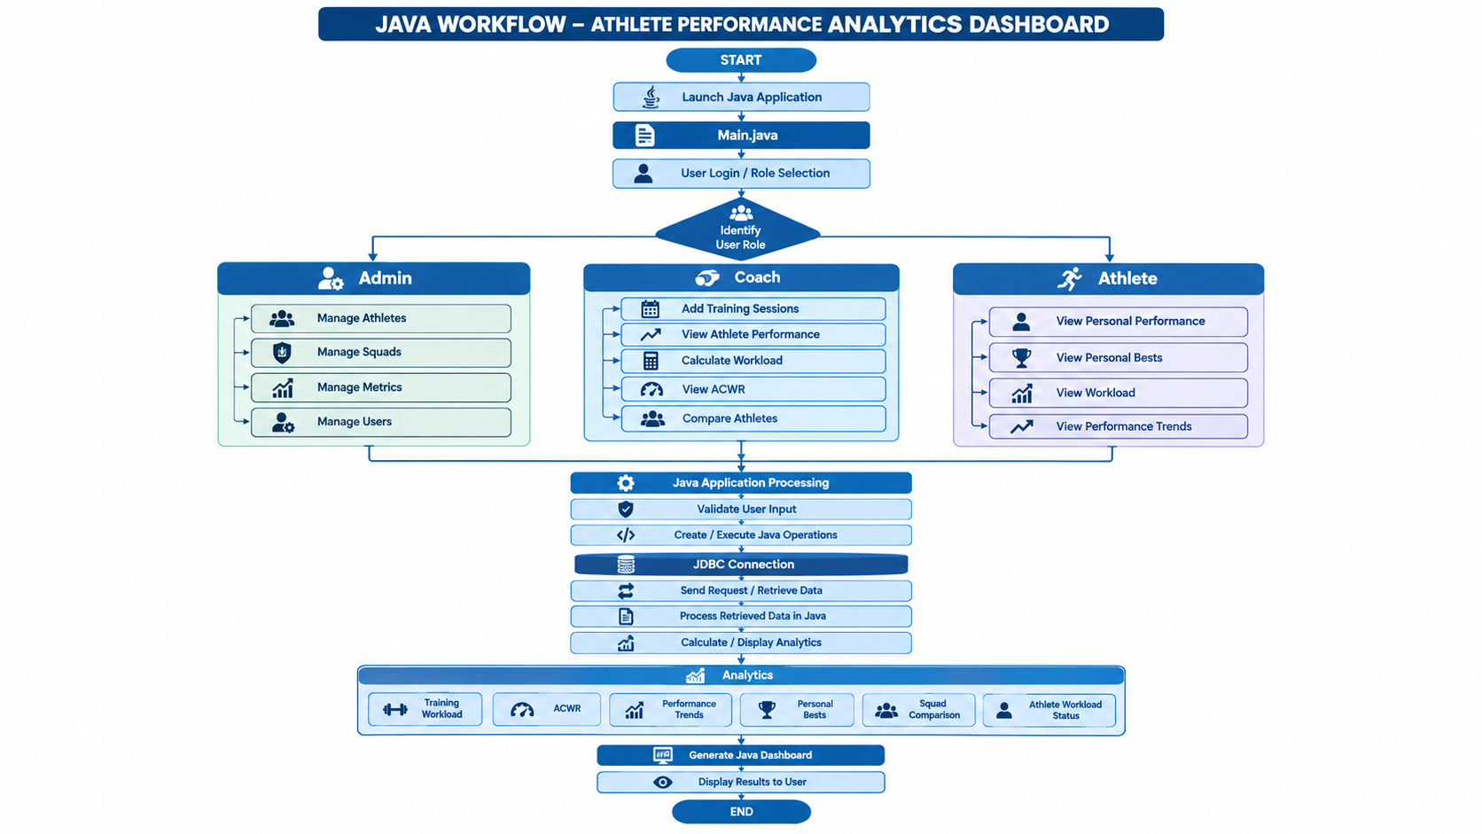






Workflow Process
RESULTS

Slide 7
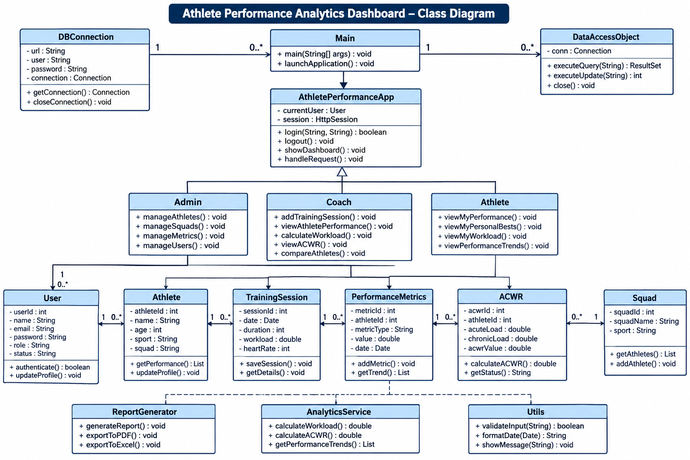

Slide 8
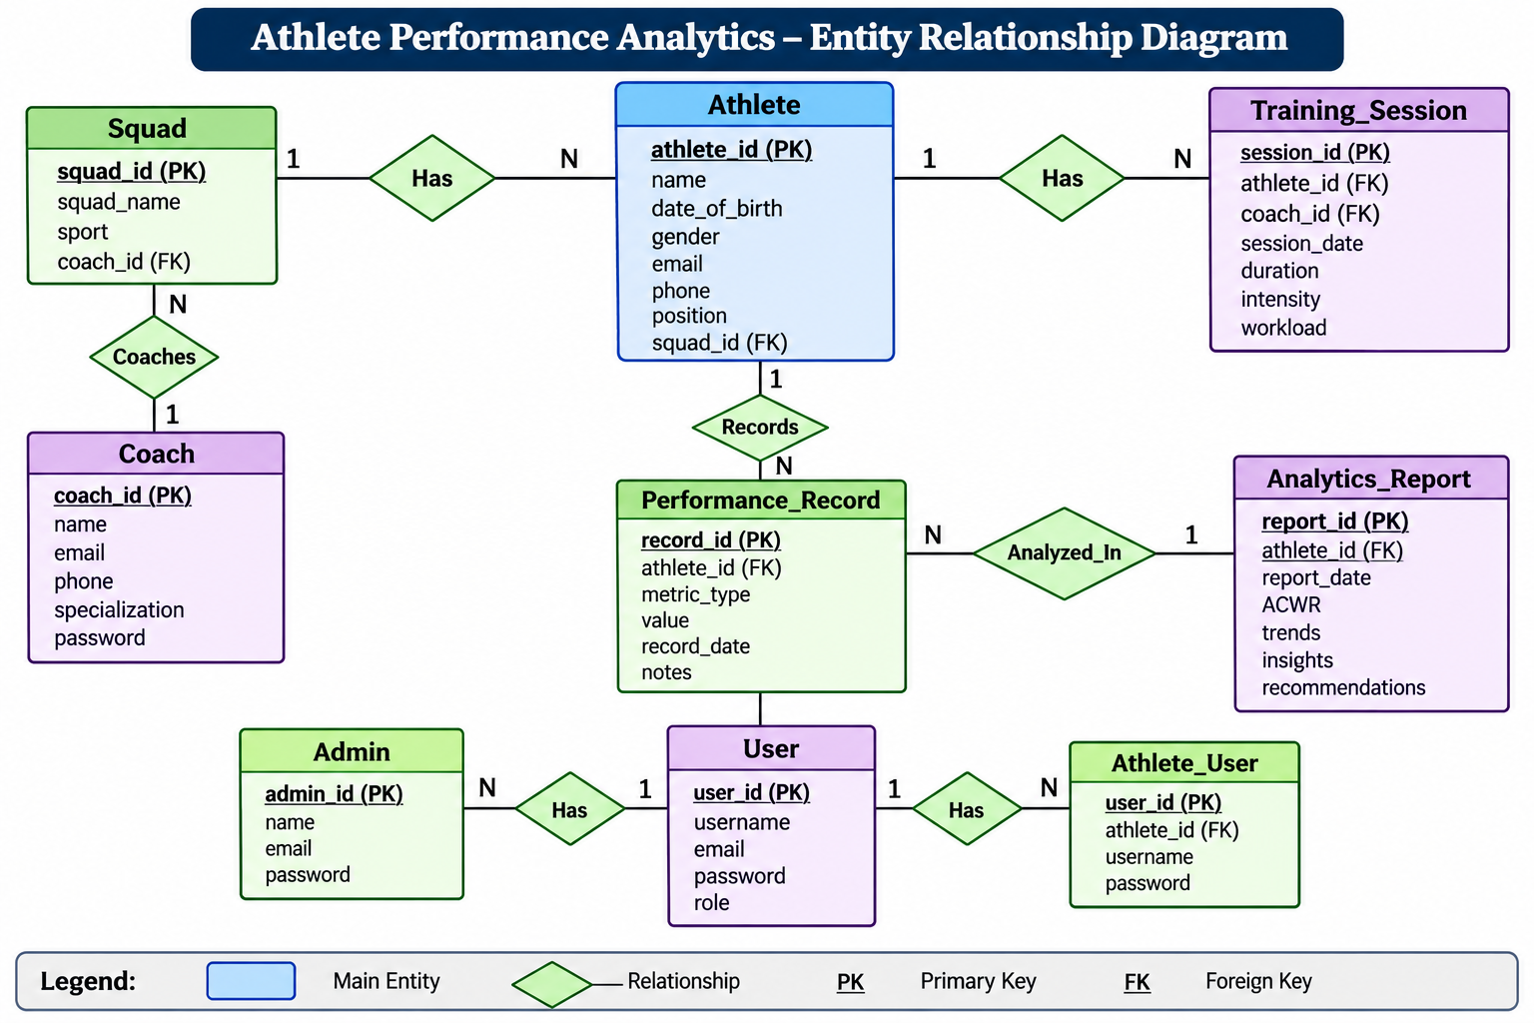

Slide 9
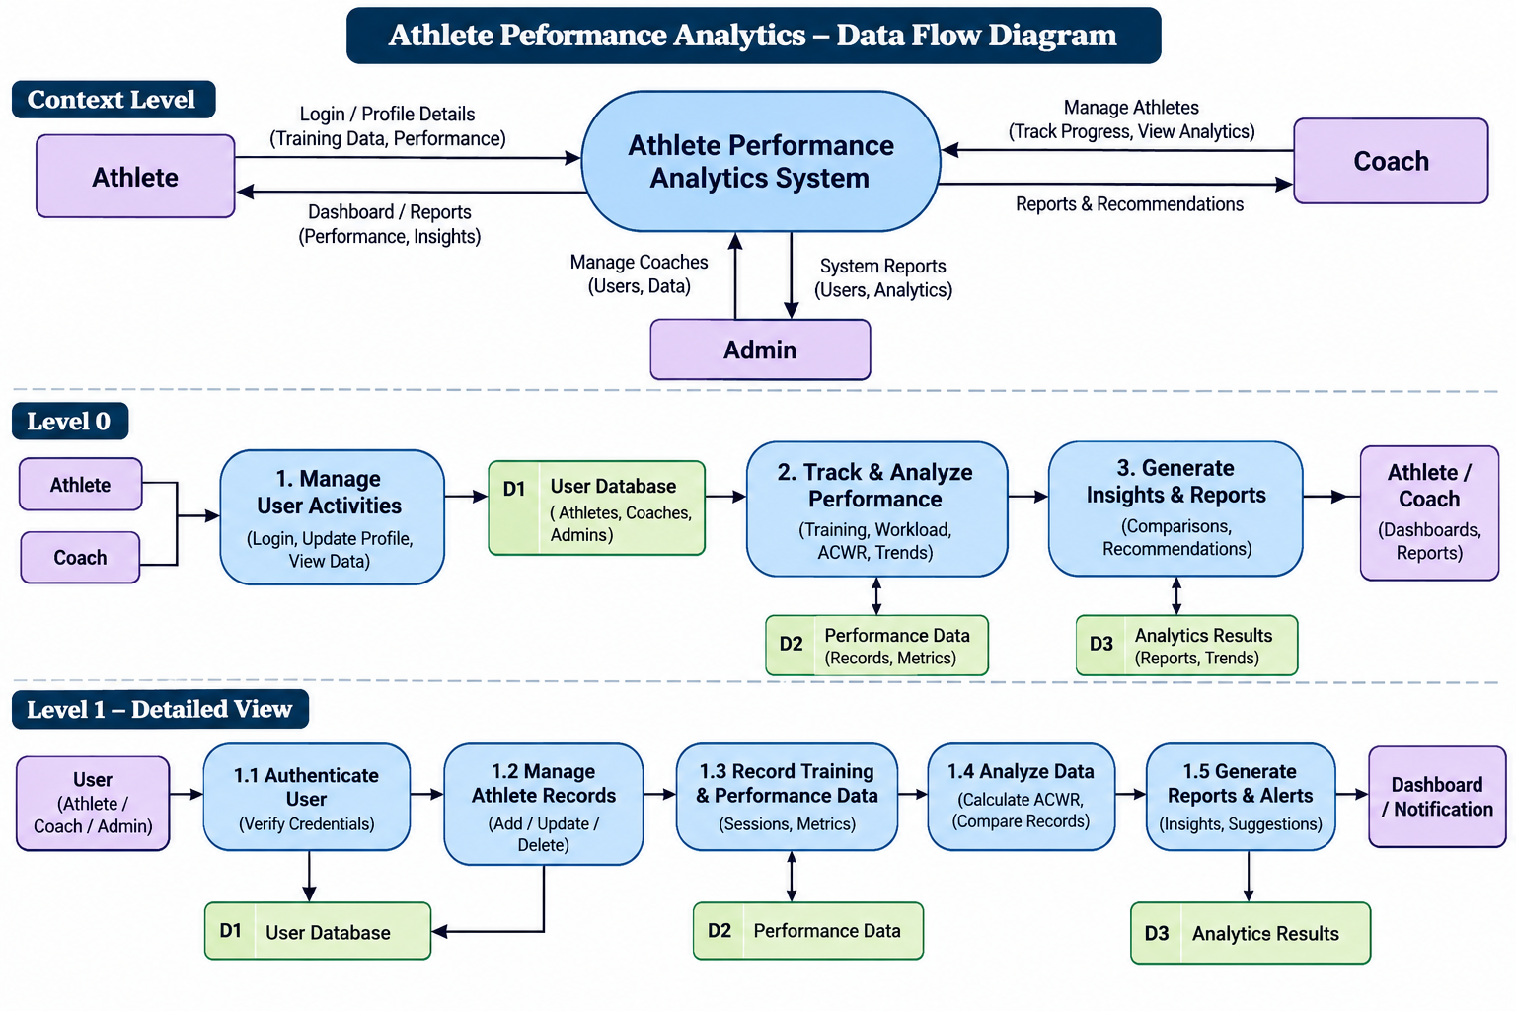

Slide 10
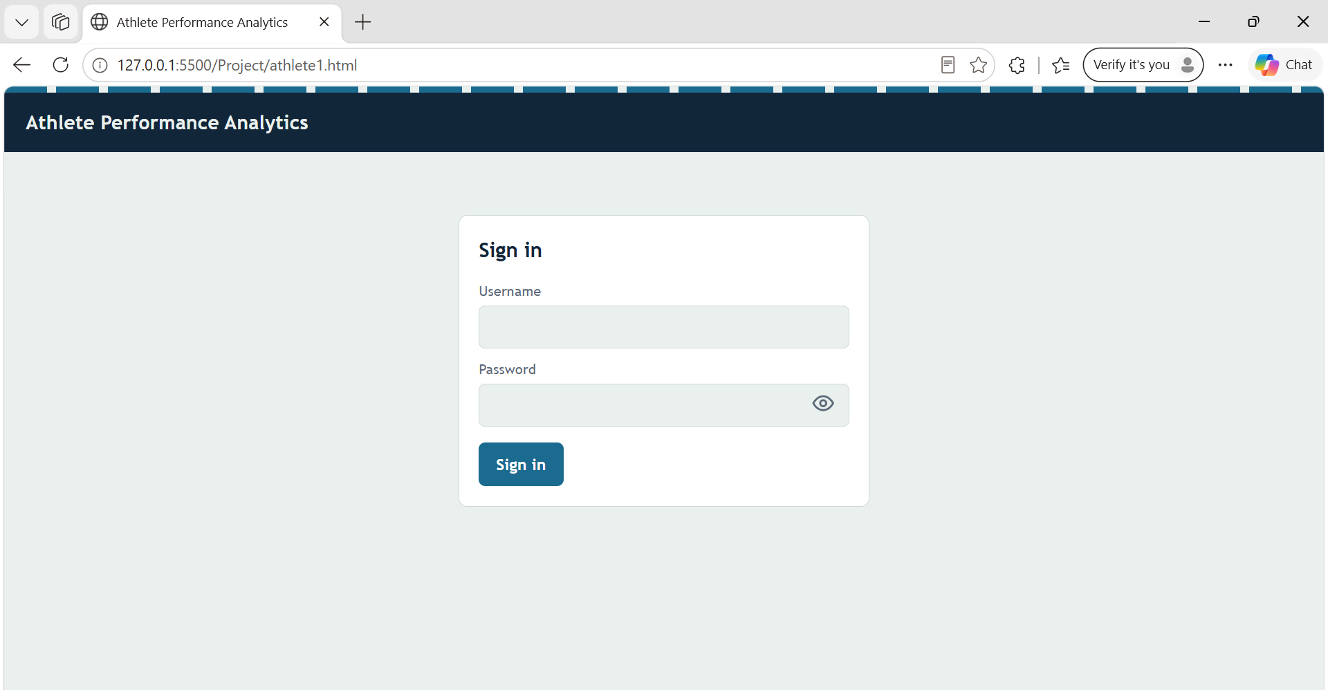
LOGIN PAGE

Slide 11
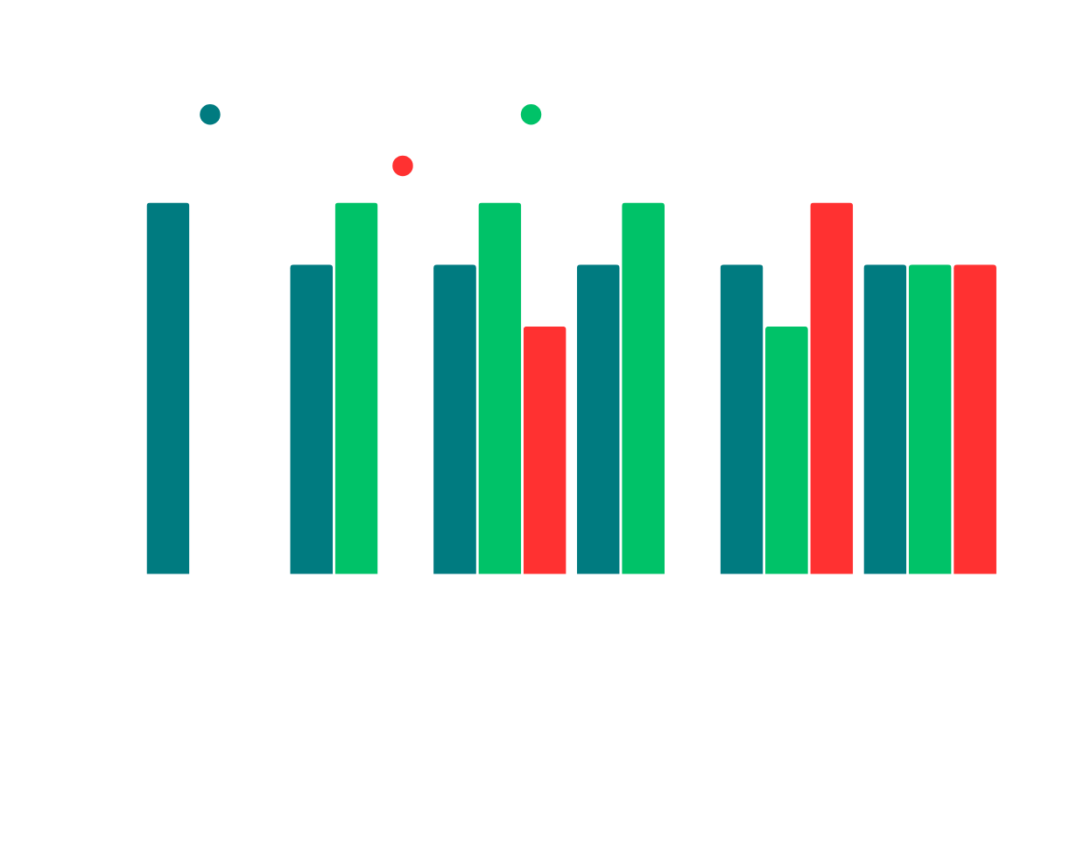
FEATURES & ROLE-BASED MENUS
Admin
• Manage coach & athlete records
• Full system access & data control
Coach / Trainer
• Enter & review training sessions
• Monitor workload & compare athletes
Athlete
• View personal performance data
• Access individual analytics & trends

Slide 12





















SWOT Analysis
Athlete Performance Analytics
Strengths
Weaknesses
  Centralized athlete data management.
  Requires accurate data entry.
  Easy tracking of athlete performance.
  Depends on database availability.
  Training workload monitoring.
  Requires basic user training.
  Separate Admin, Coach, and Athlete roles.
  Limited analytics with insufficient historical data.
Opportunities
Threats
  Adoption by colleges and sports academies.
  Risk of unauthorized data access.
  Integration with wearable devices.
  Competition from existing sports applications.
  Online access from multiple devices.
  Server failures or service interruptions.
  Advanced analytics and automated reports.
  Incorrect data leading to misleading results.

Slide 13
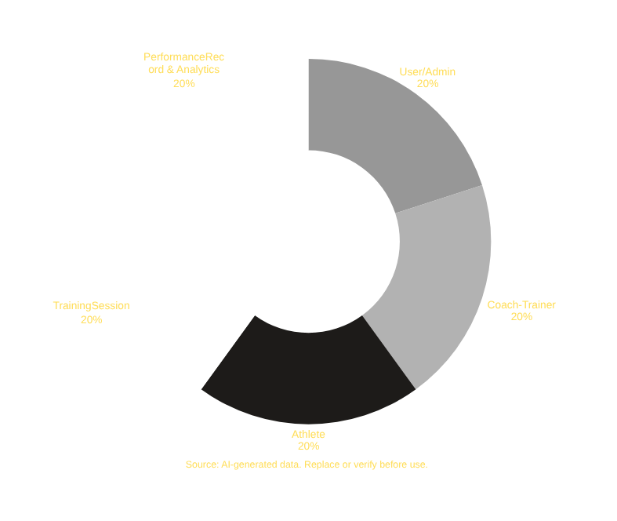
CONCLUSION
THE ATHLETE PERFORMANCE DASHBOARD IS A UNIFIED JAVA AND MYSQL-BASED APPLICATION THAT MANAGES AND ANALYSES DATA ABOUT THE PERFORMANCE OF THE ATHLETE TO MONITOR TRAINING AND WORKLOAD, TRACK AND COMPARE THE ACWR VALUES, ASSESS PERSONAL BESTS, AND EVALUATE TRENDS. THE APPLICATION USES JAVA, JDBC, MYSQL DATABASE, MYSQL WORKBENCH, AND PL/SQL WITH CUTTING-EDGE CAPABILITIES TO CREATE A RELIABLE AND INTEGRATED SYSTEM THAT MANAGES AND ANALYSES THE PERFORMANCE DATA INTENSIVELY TO OFFER INSIGHTS THAT IMPROVE THE QUALITY OF COACHING.

Slide 14


